Slide 1
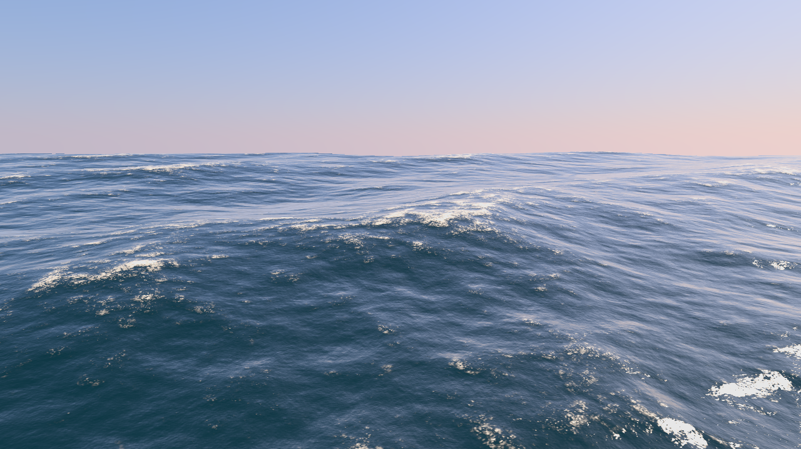
Ocean Surface Generation and Rendering
Thomas Gamper
Research Division of Computer Graphics
Institute of Visual Computing & Human-Centered Technology
TU Wien, Austria

Slide 2

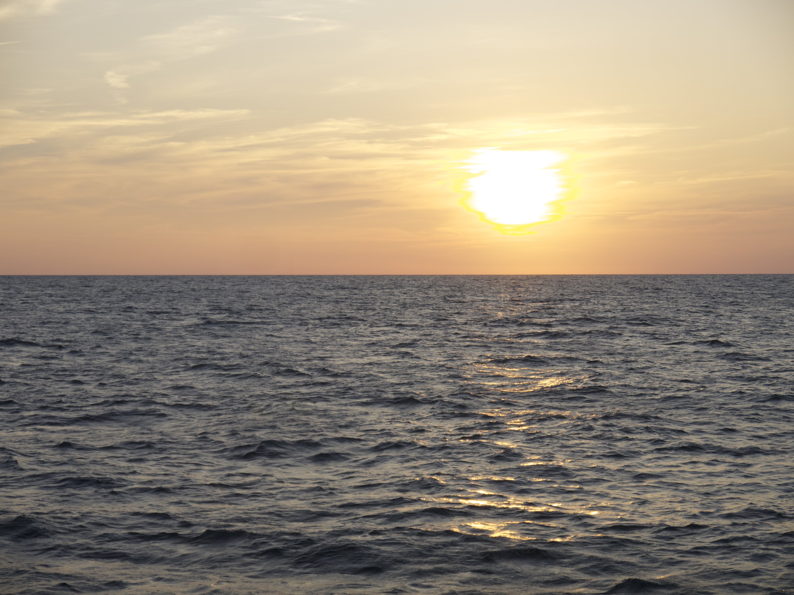
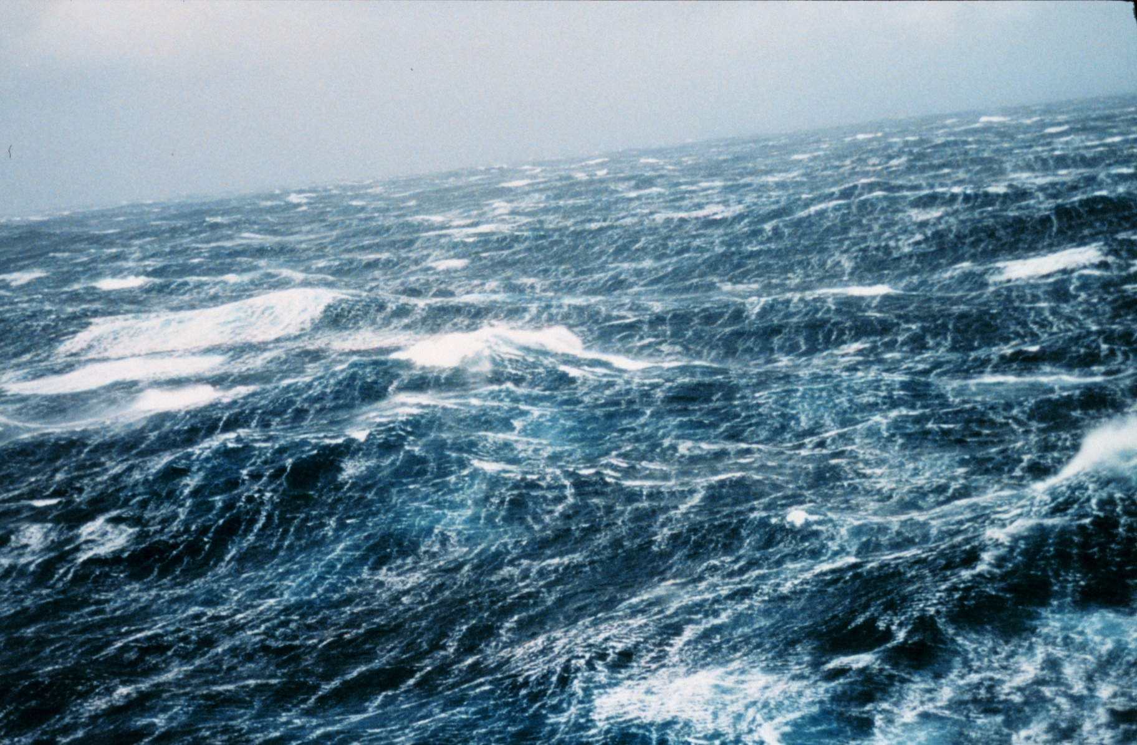
Motivation
Generation and rendering of the animated ocean surface in real time.

Slide 3
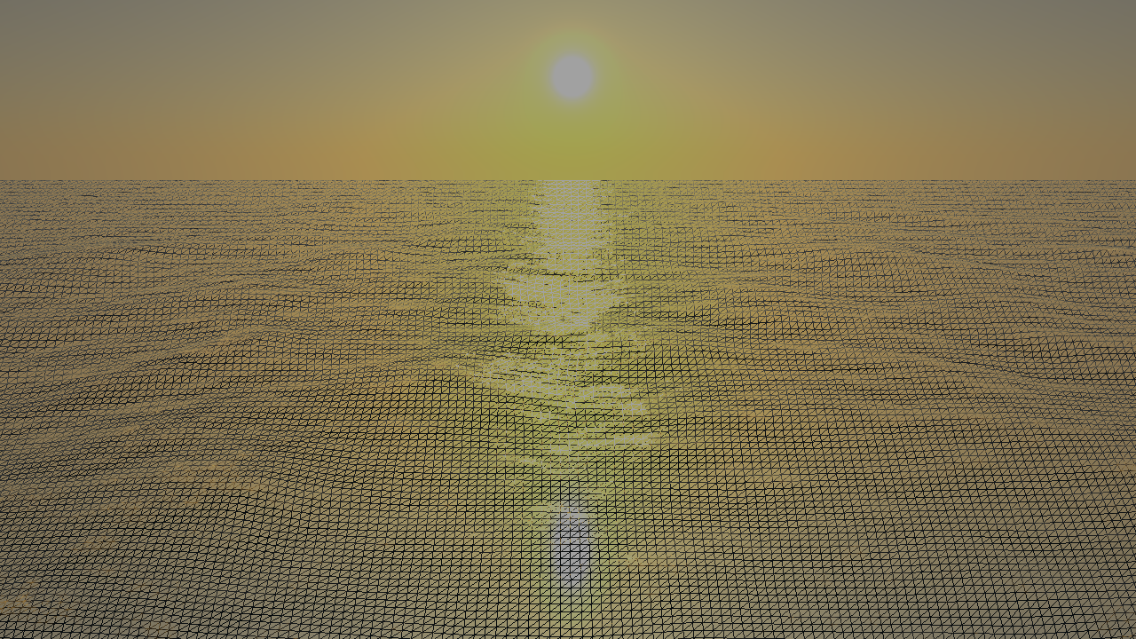
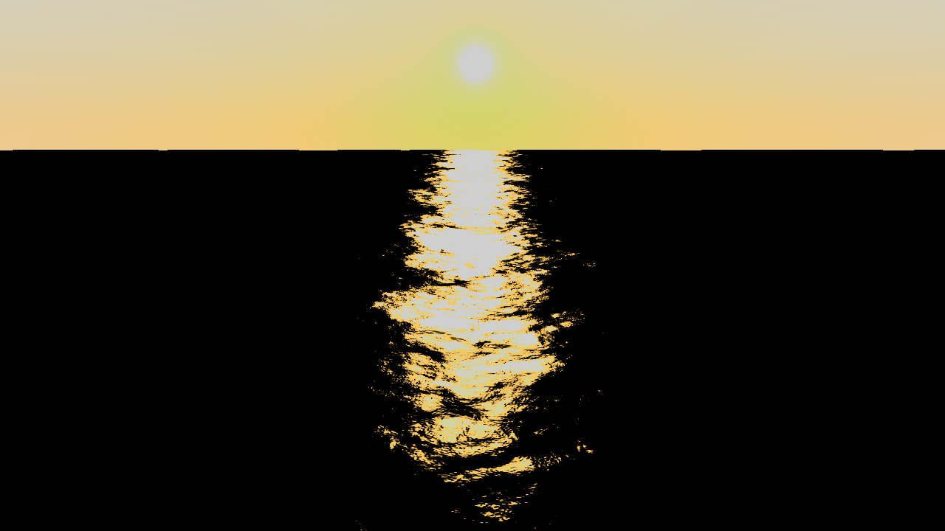
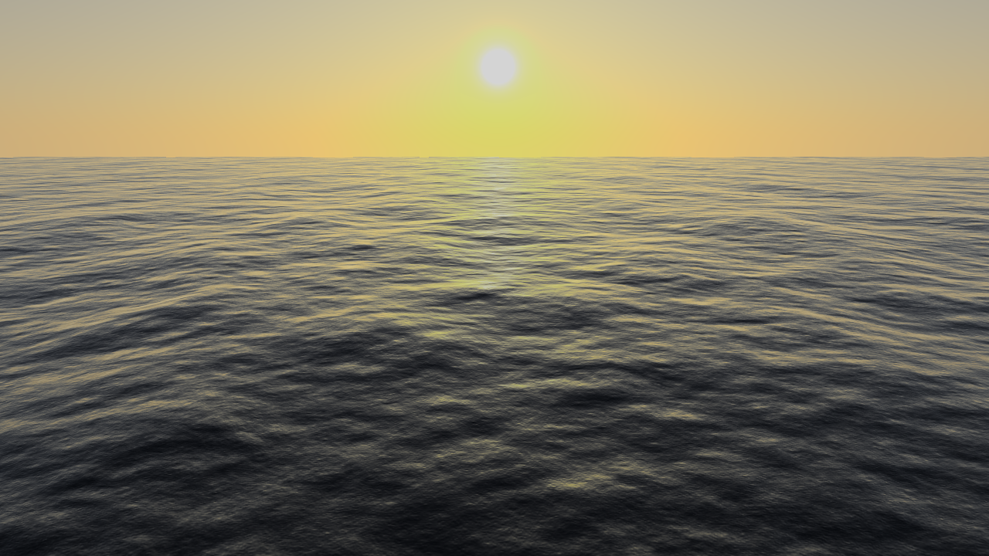
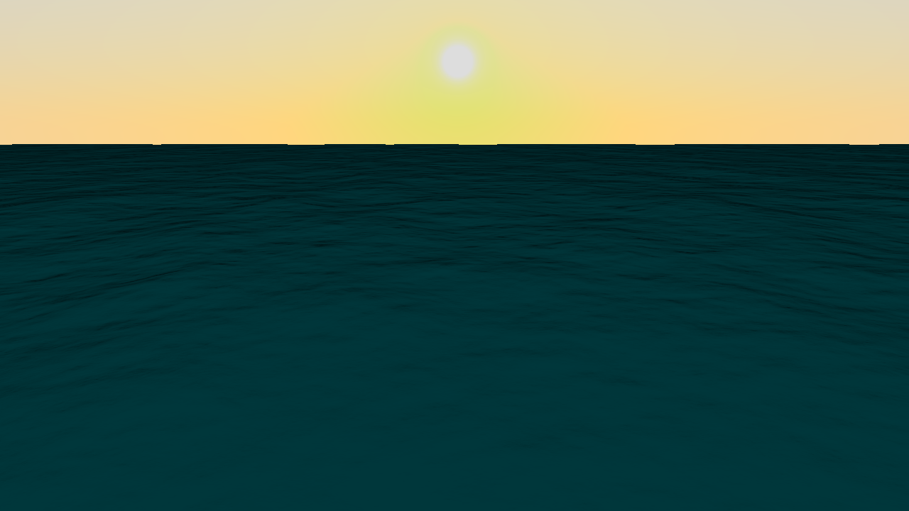
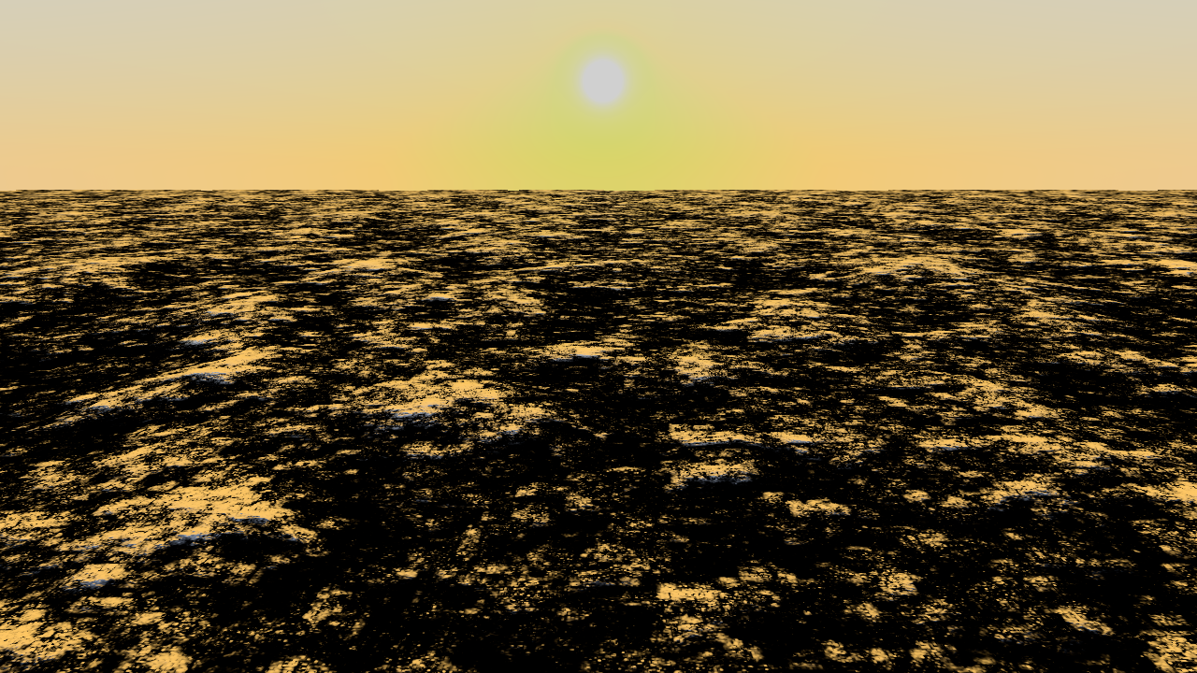
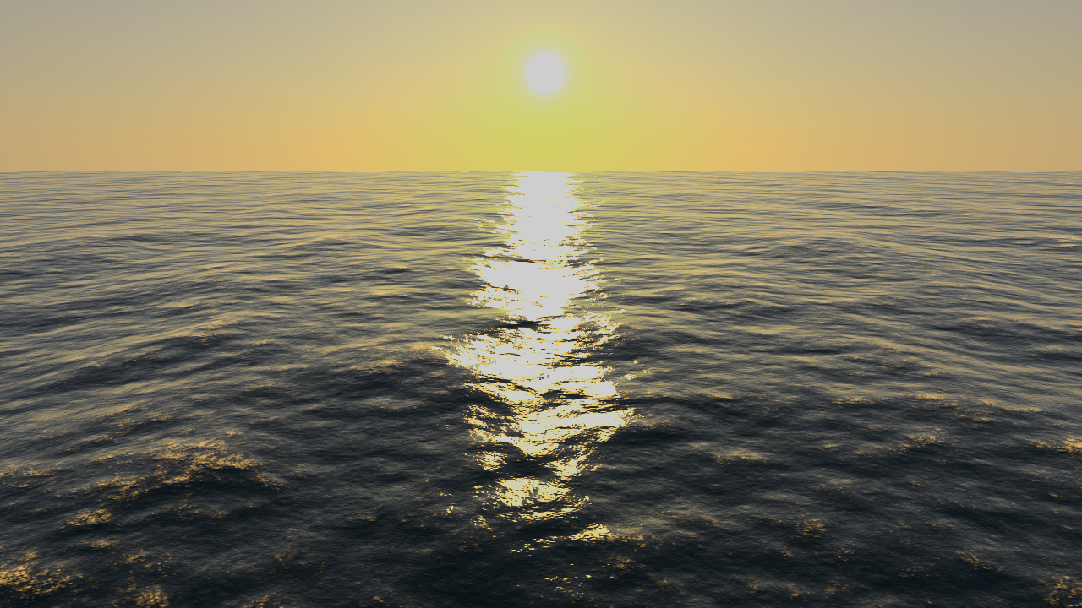
Related Work
Choppy wave algorithm [Tessendorf1999]
Employs wave spectrum concept from oceanography
Adapted for real-time operation [Brunetone2010, Dupuy2012, Johanson2004]

Slide 4
Problems
Choice of wave spectrum
Many distinct models
Which ones to use?
Performance
Surface synthesis
Level of detail

Slide 5
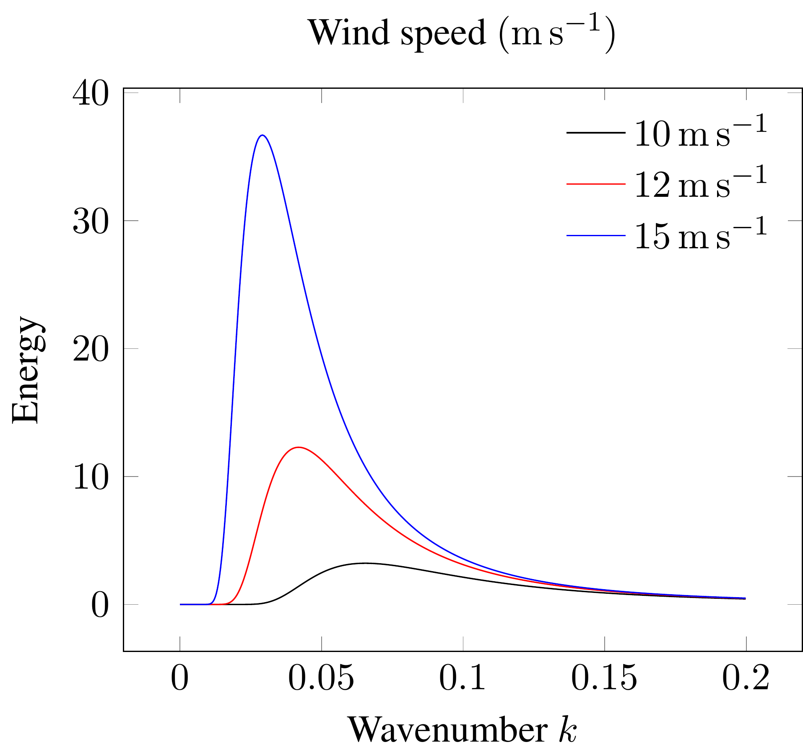
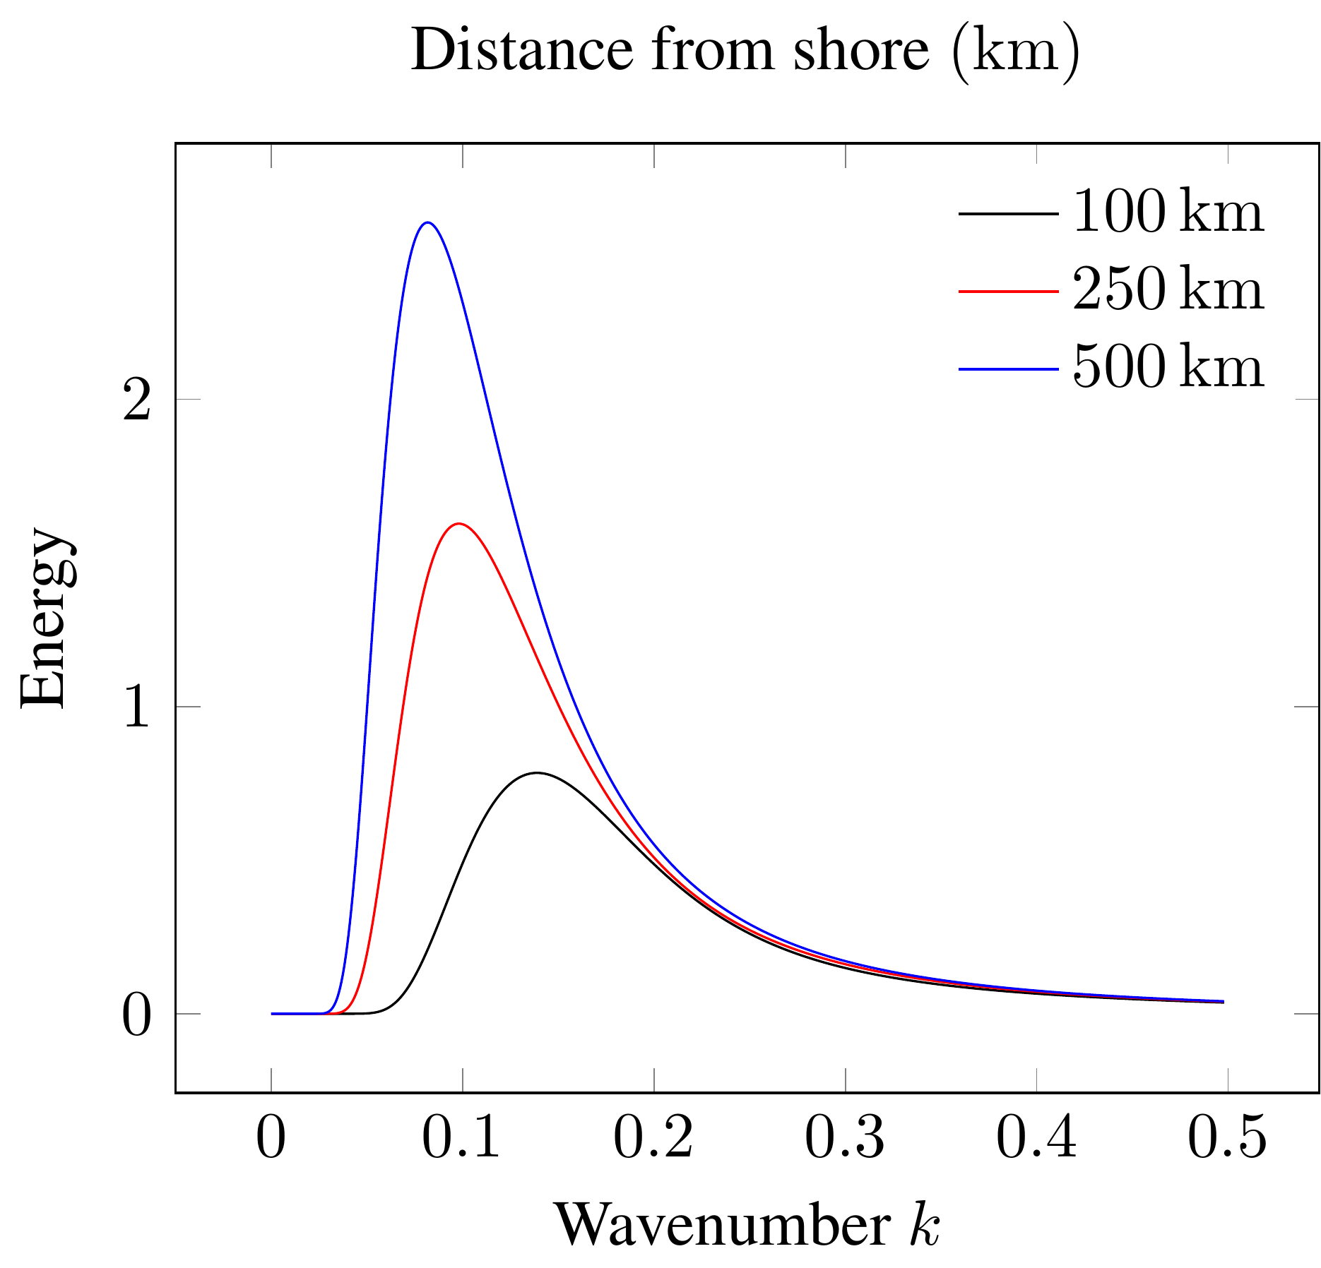
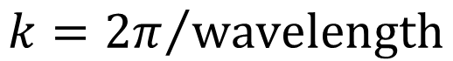
What is the Wave Spectrum?
Wave energy in frequency space.
$$k={2π}/{wavelength}$$
Notes:
The wave spectrum describes the distribution of energy among waves.

Slide 6
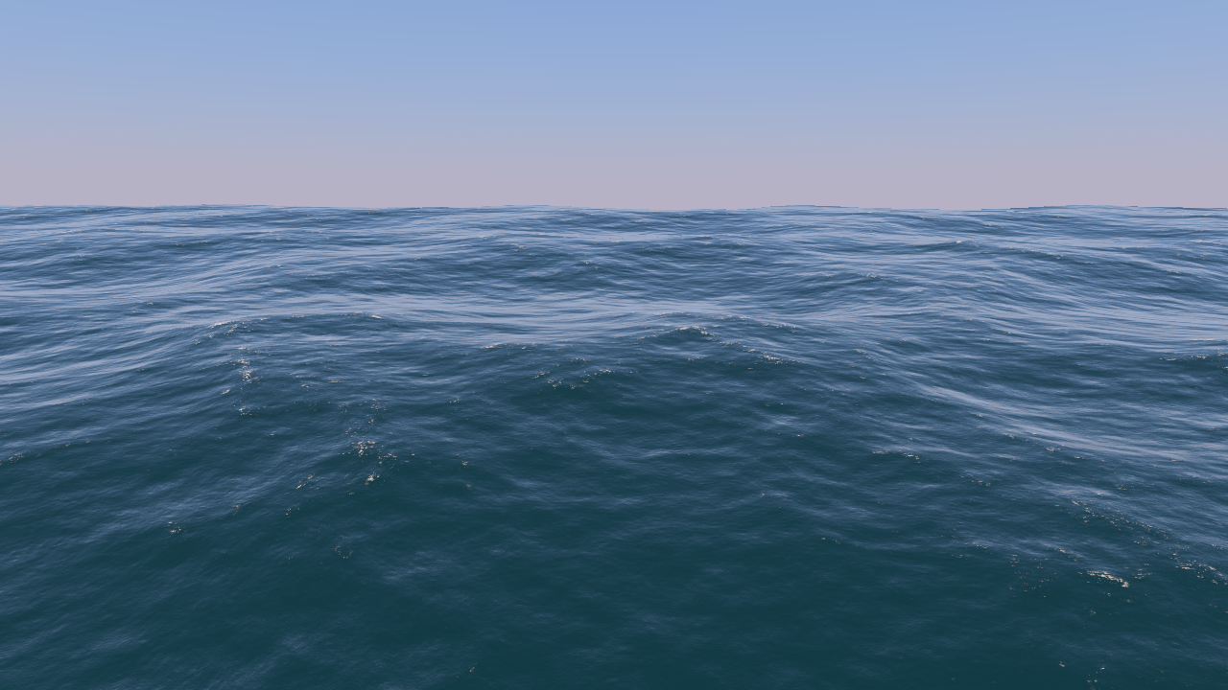
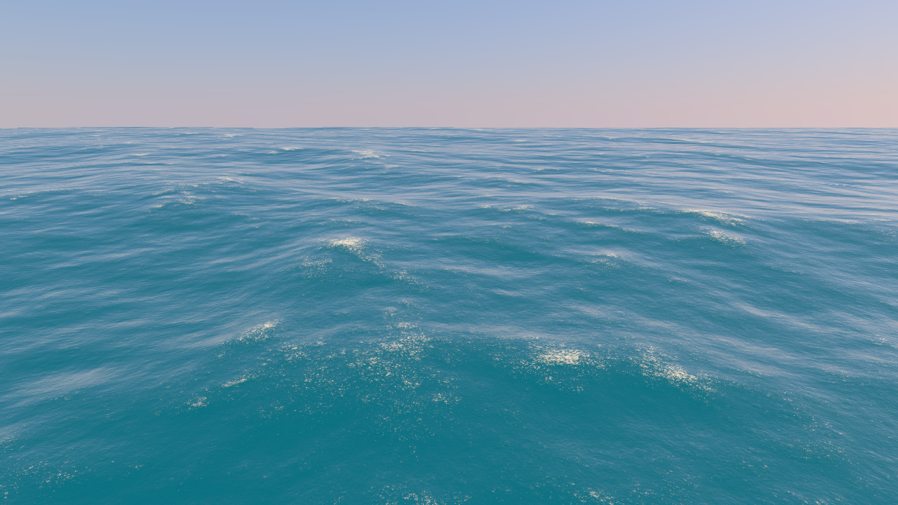
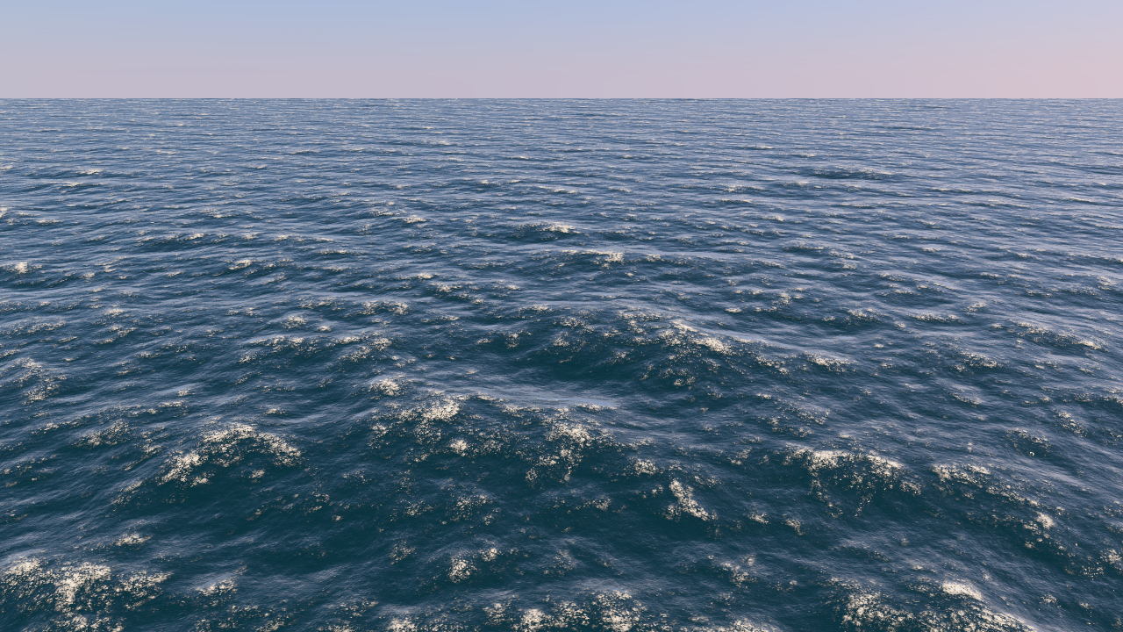
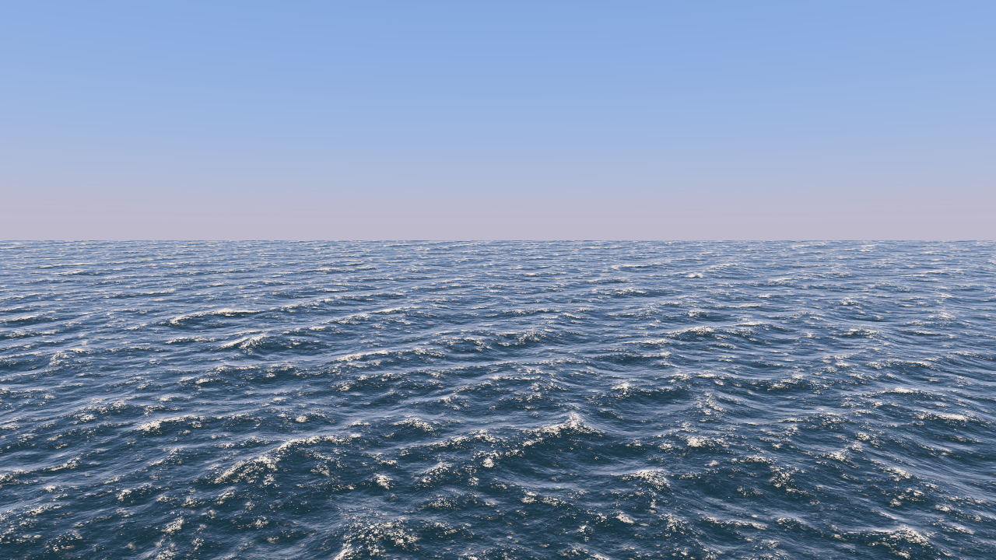
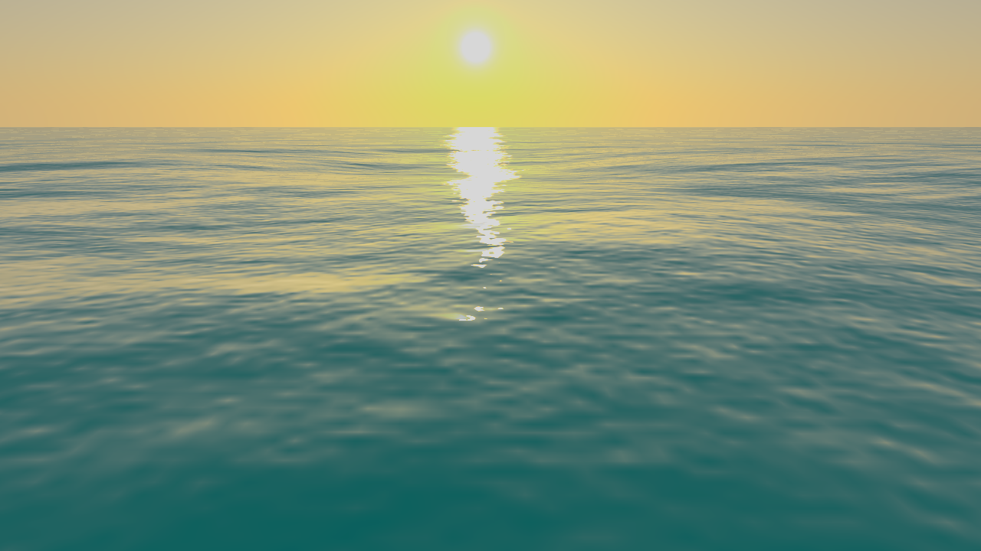

Wave Spectrum Models
Pierson-Moskowitz
Gentle seas
JONSWAP
Agitated seas
Unified
Remaining seas

Slide 7
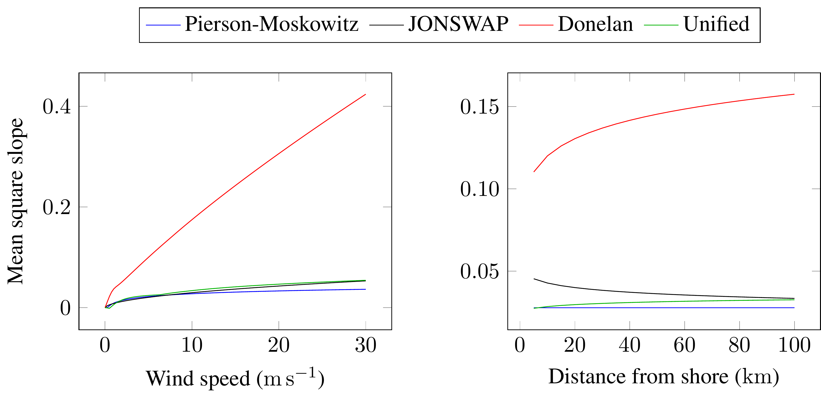
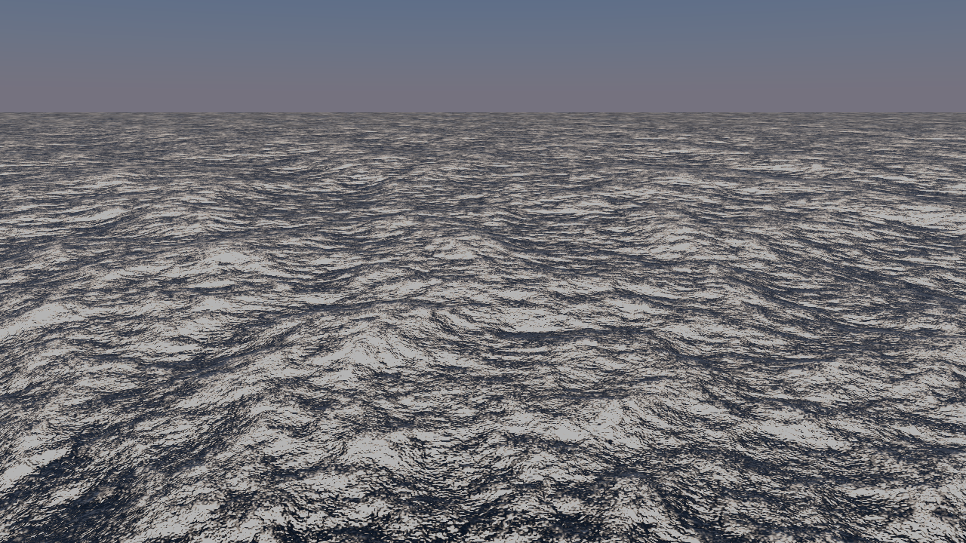
Wave Spectrum Models
Donelan spectrum: defective lighting
Notes:
Lighting algorithm is based on the mean square slope. The mean square slope is a measure for the surface’s roughness. Donelan severely overestimates mss, thus lighting is broken. Similar issue with JONSWAP at low fetch, but easy to avoid.

Slide 8
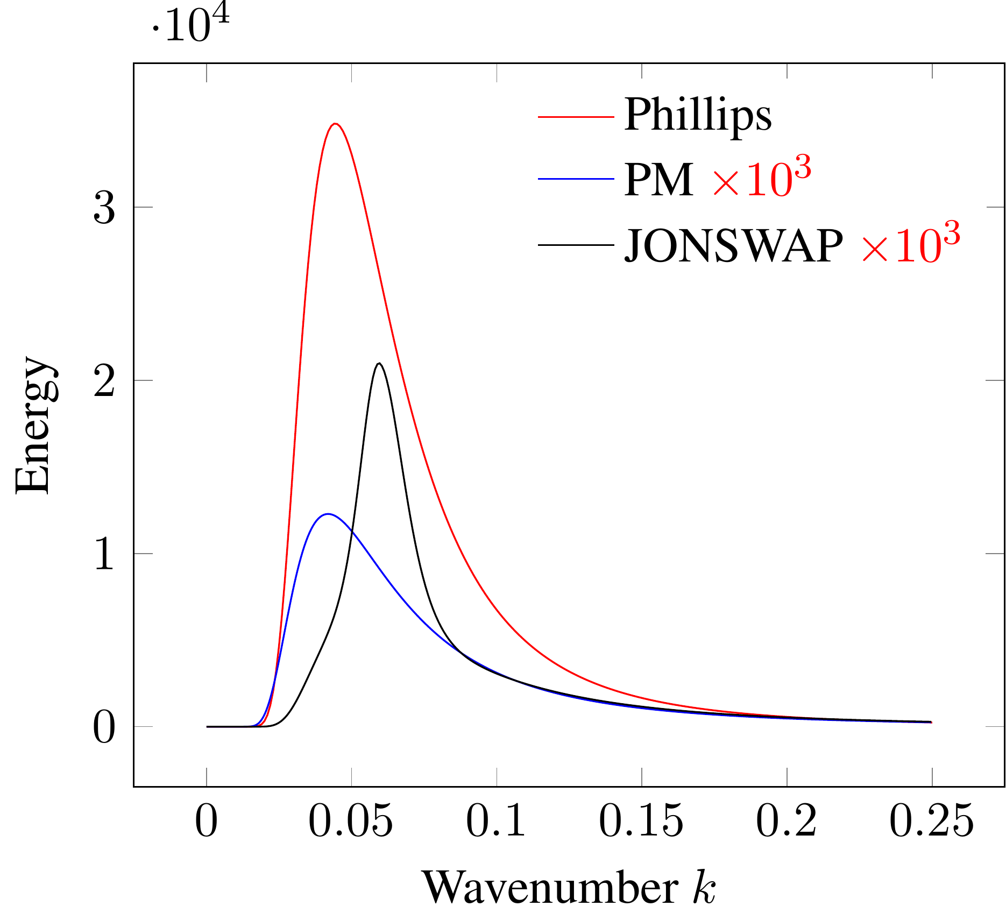
Wave Spectrum Models
Phillips spectrum: defective model
Notes:
Was ist kaput?
Phillips spectrum’s scale is off the charts. Only usable with additional, user-controlled scaling parameters.

Slide 9
Wave Spectrum Models
Flawless
Pierson-Moskowitz
Unified
Minor issues
JONSWAP
Defective
Donelan
Phillips

Slide 10
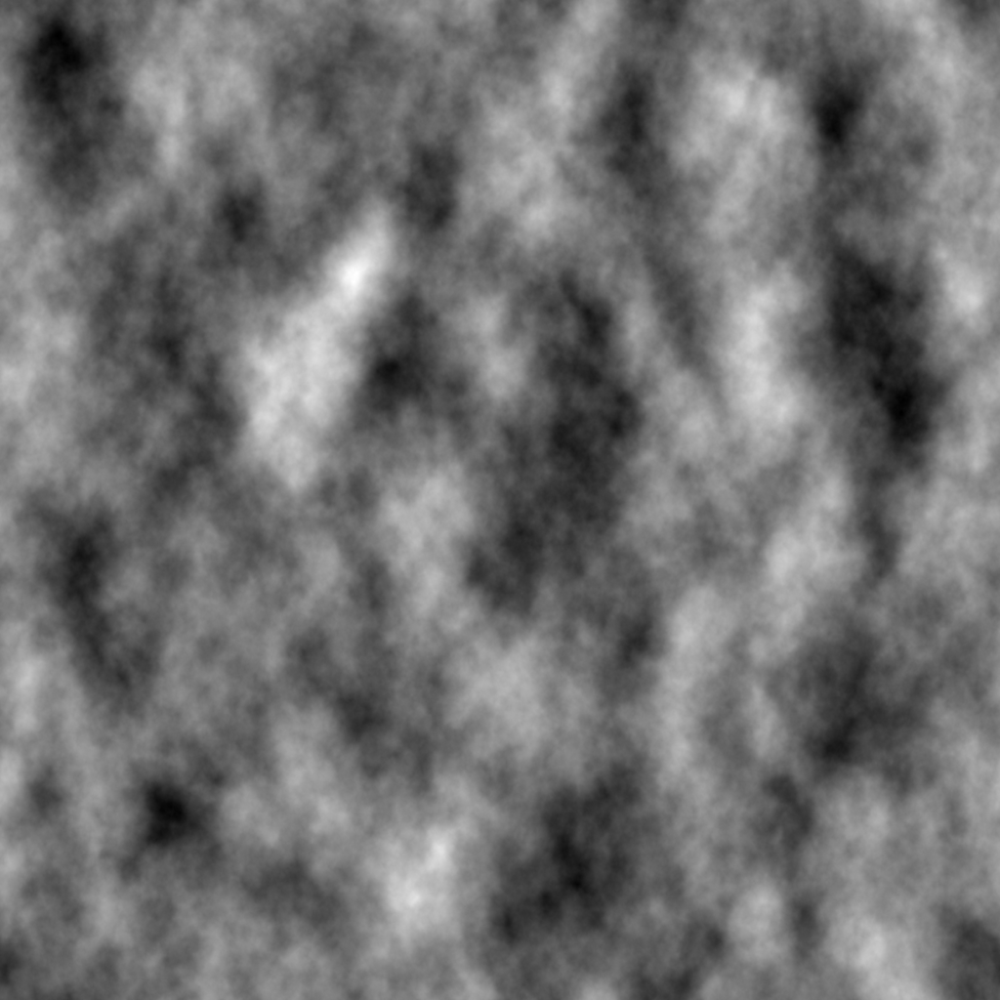
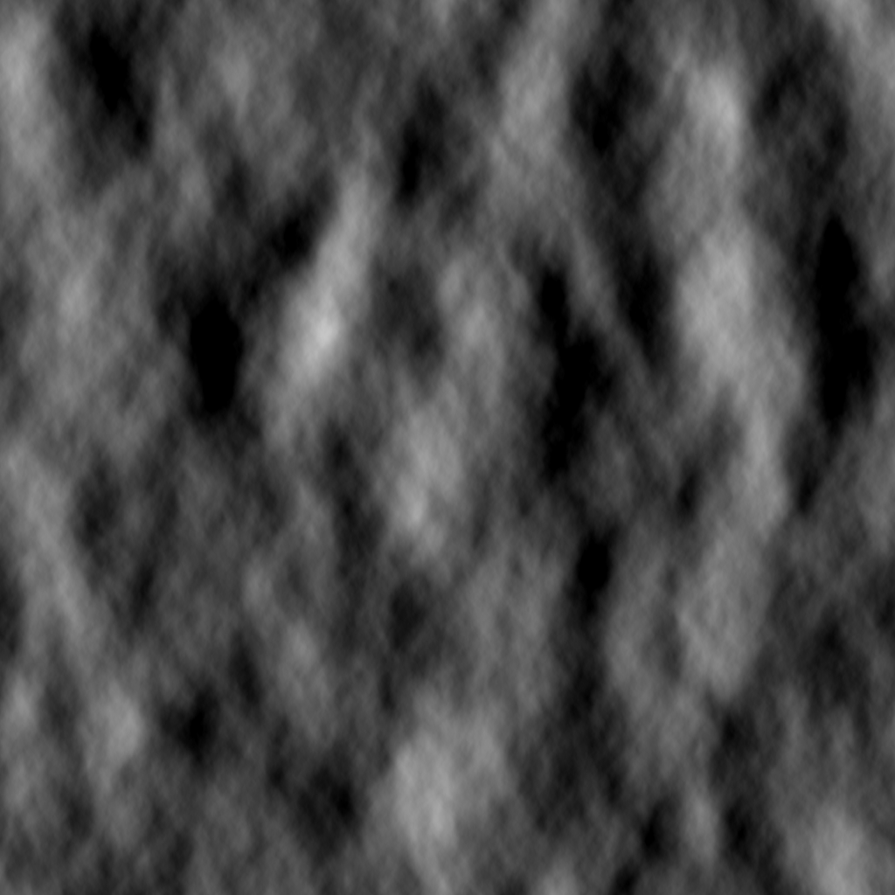
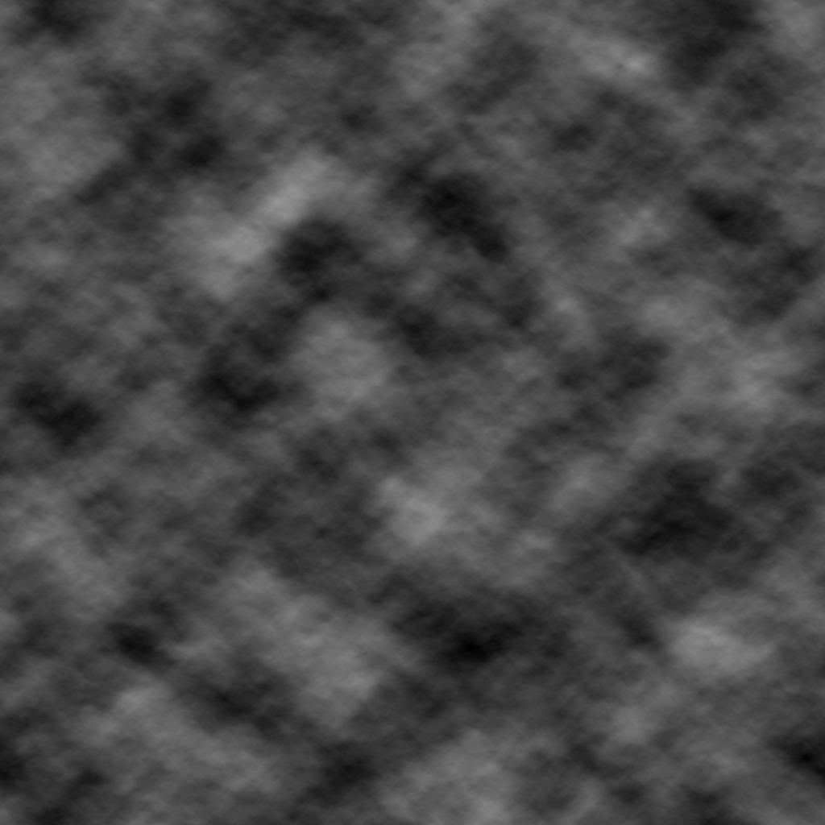
Performance
Surface synthesis
Preprocessing
Dataset generation
Inverse Fourier Transform
Heights
Displacements
1st order partial derivatives
+
+

Slide 11
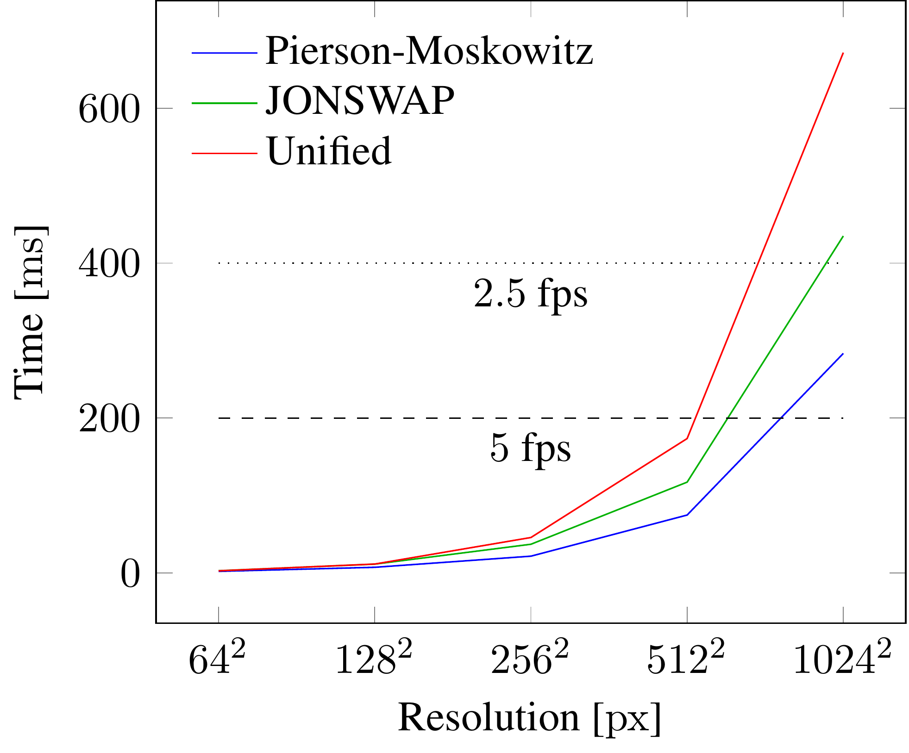
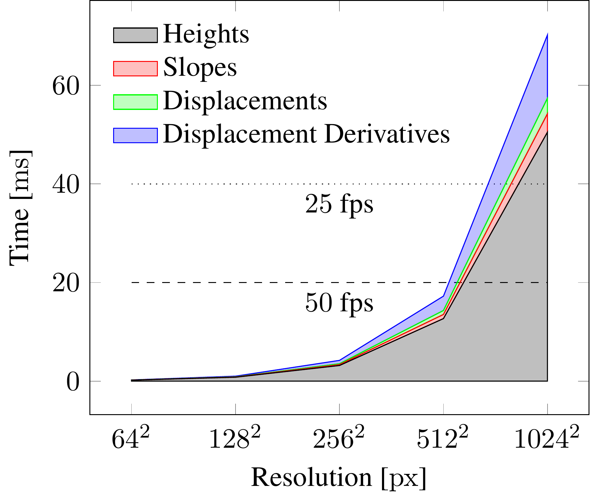
Performance
Preprocessing
Dataset generation
Notes:
Preprocessing: Generate spectrum just once.
Generate 9 datasets: share large part of arithmetic, additional time is caused by stores to memory.

Slide 12
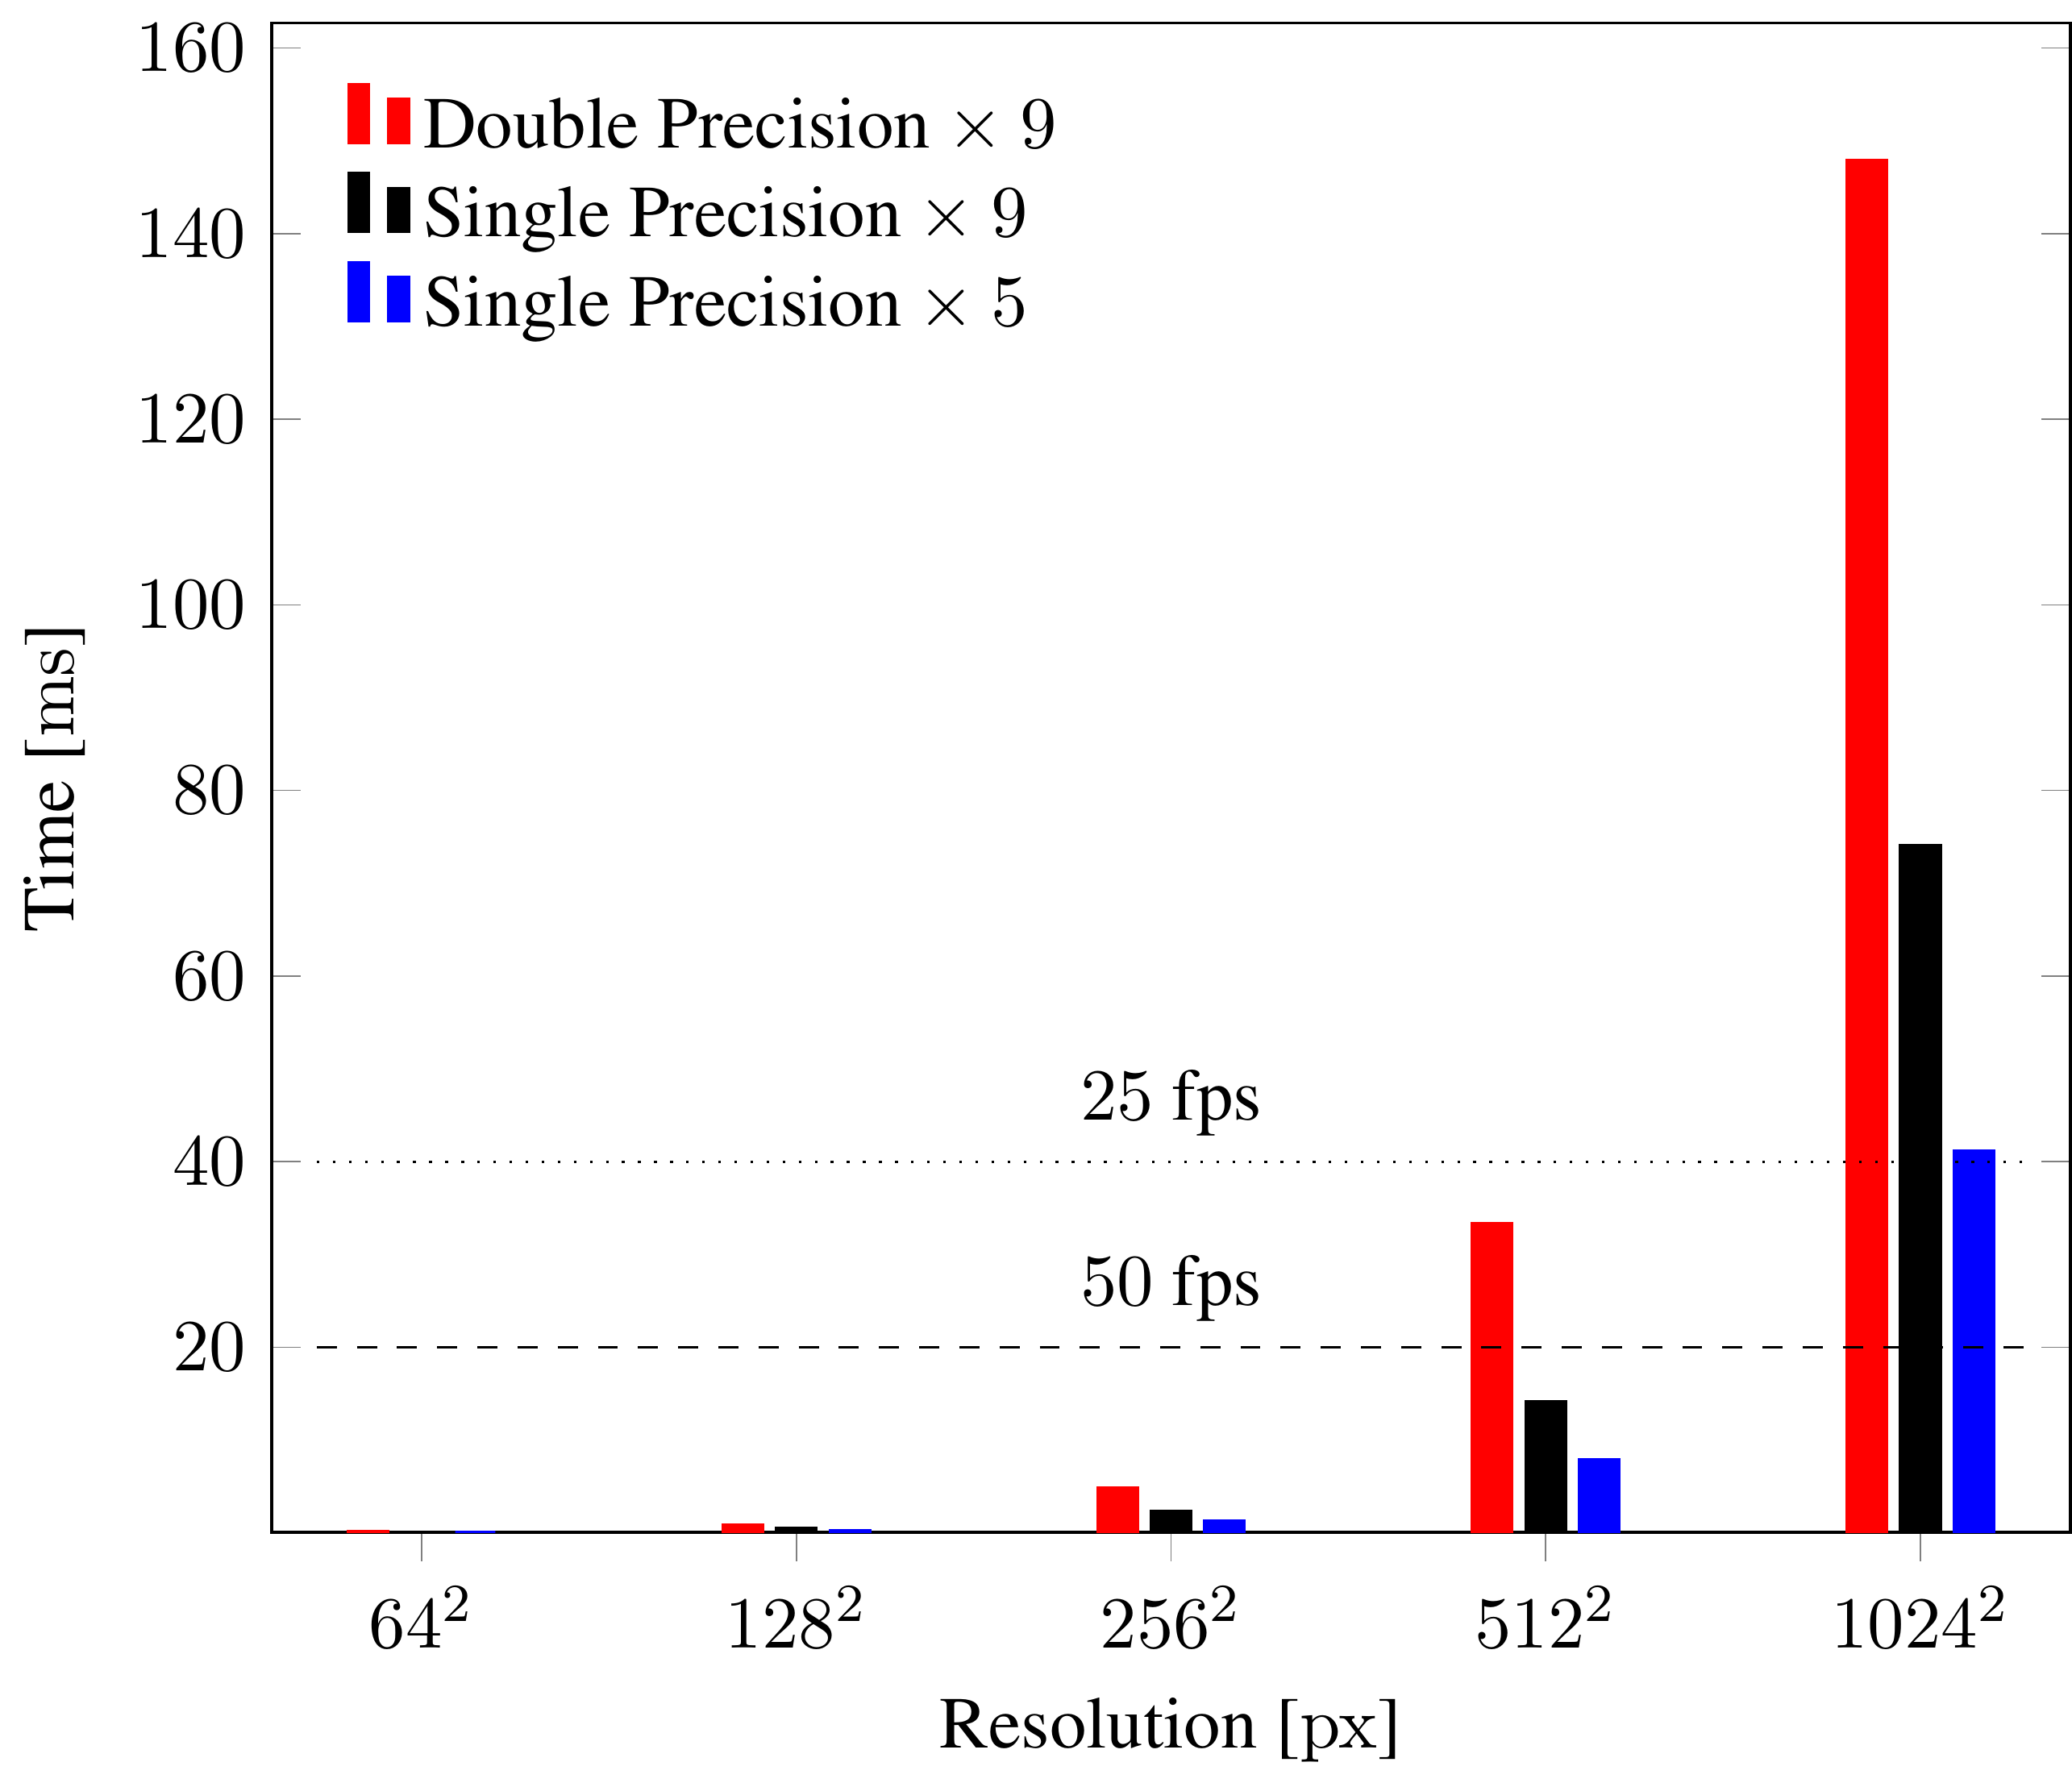
Performance
Inverse Fourier Transform
Switch to single precision
Compute two transforms at once
Approx. 70% speedup
Notes:
Welche symmetrie?
Improve IFT performance by reducing precision and transforming two datasets with a single transform.

Slide 13
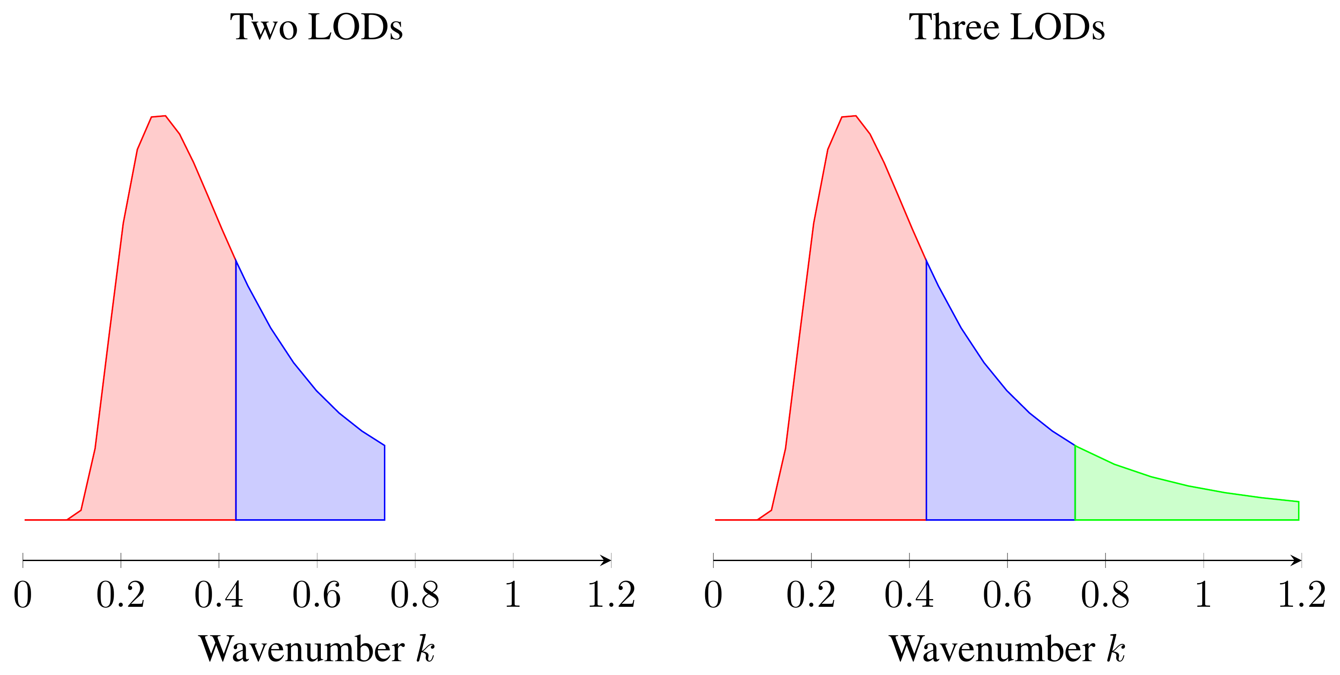
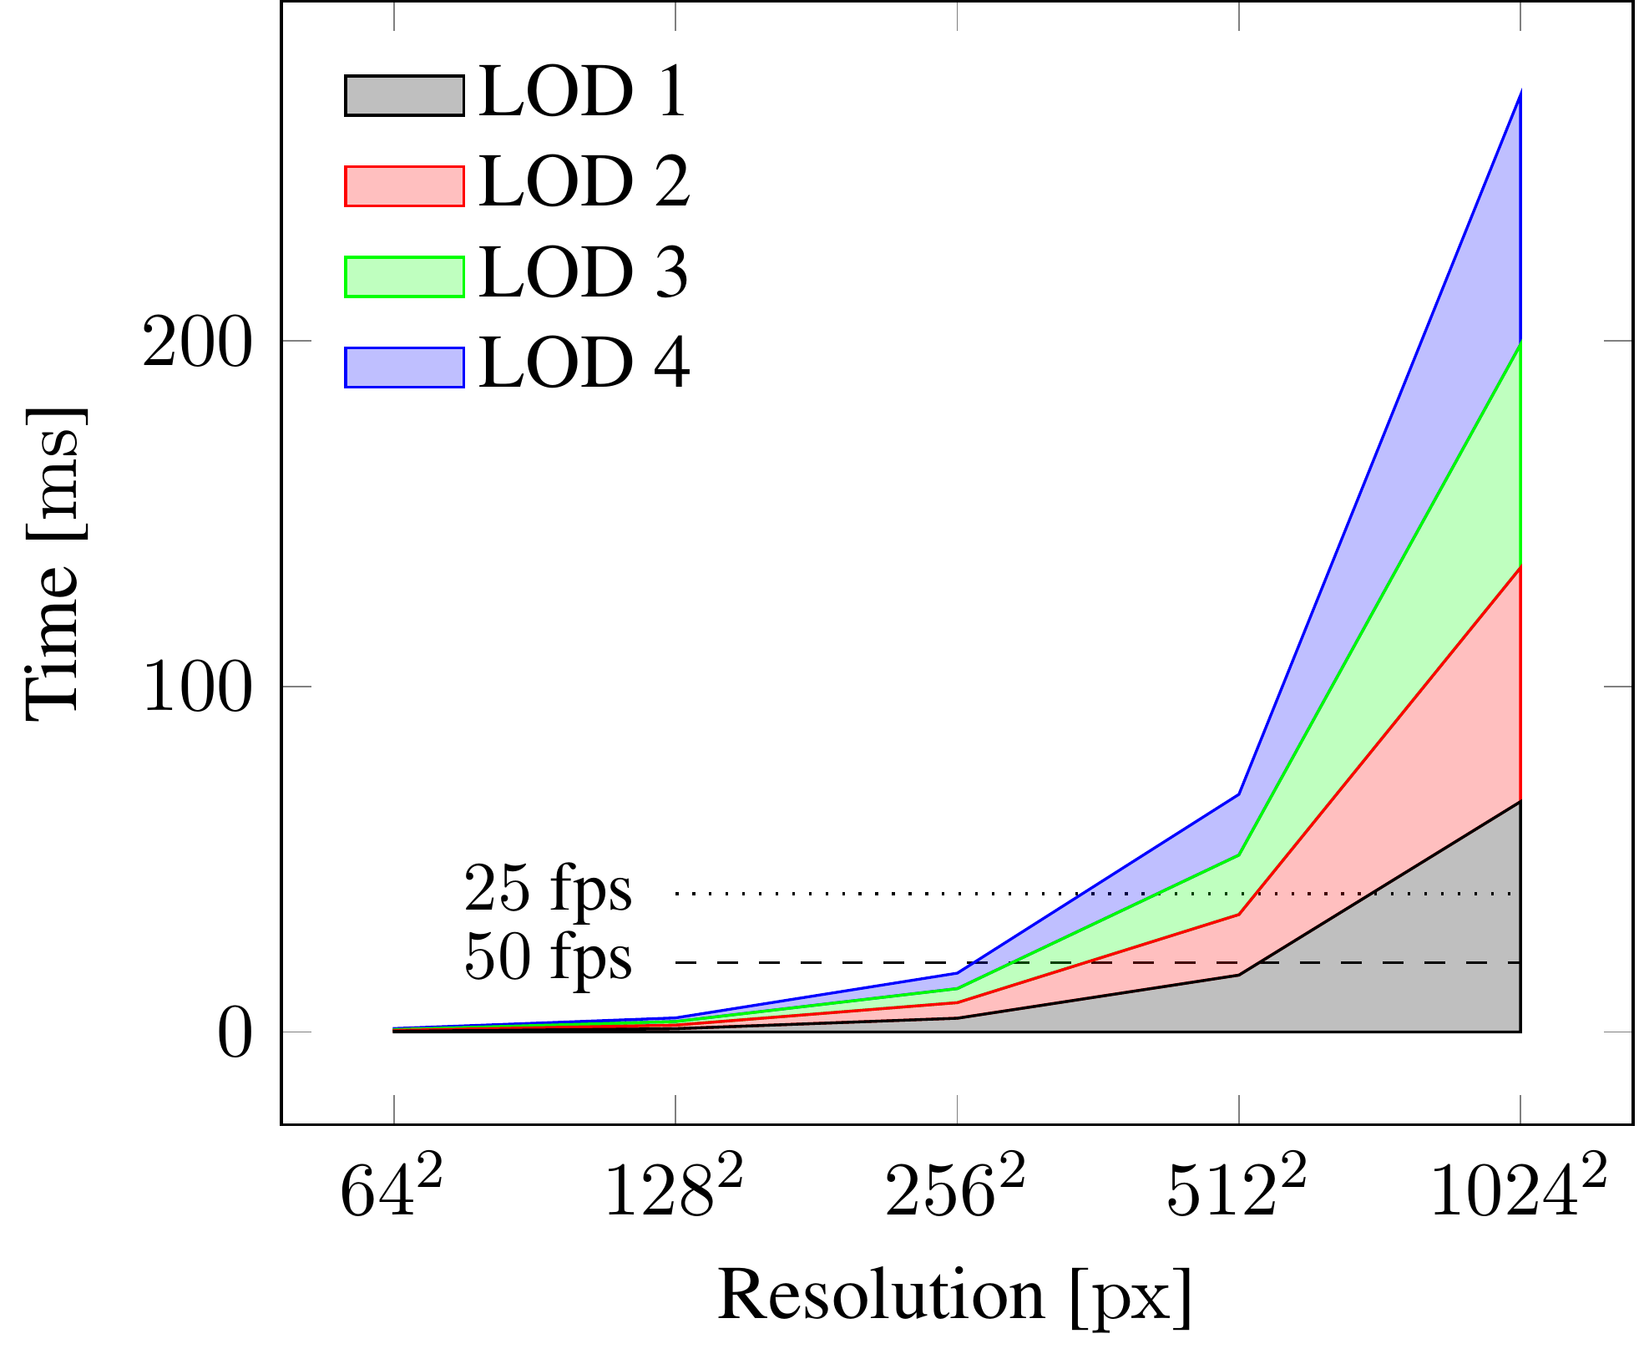
Performance
Level of detail
Refinement using additional wavenumbers
Additional LODs are costly
Notes:
Sample additional parts of the spectrum. Make sure no overlap. Generate all datasets for each LOD.

Slide 14
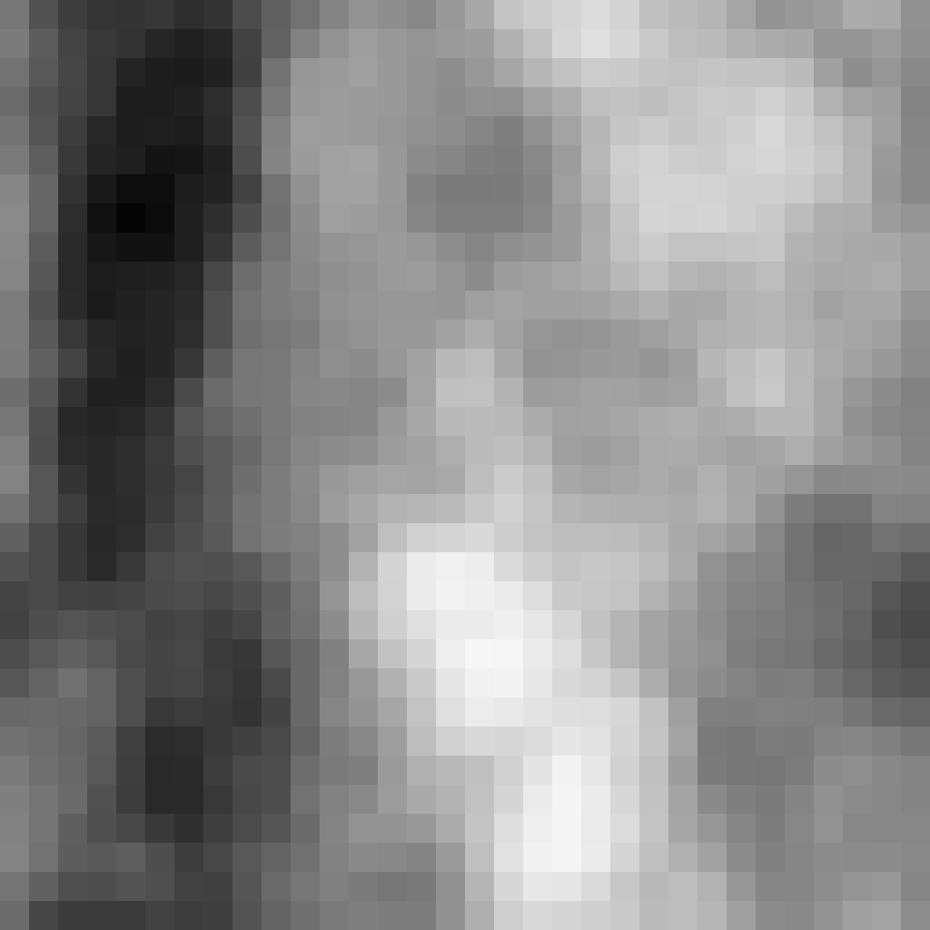
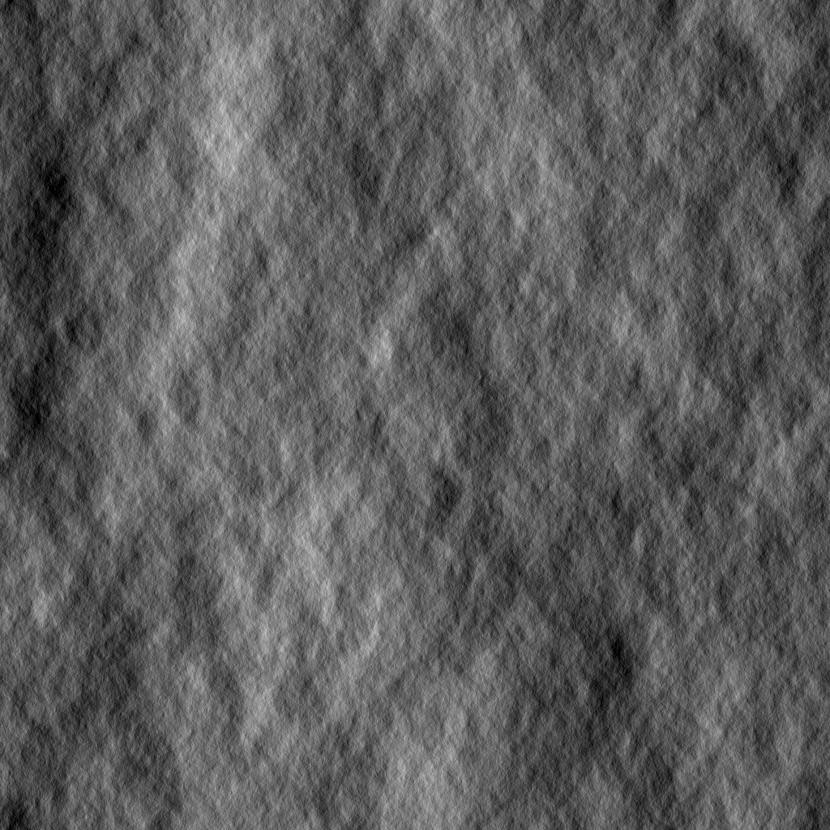

Performance
Level of detail
Switch to lower resolution for geometry
Keep high resolution for derivatives
Max. 10% speedup for dataset generation
Max. 40% speedup for Inverse Fourier Transform
No significant drop in visual quality
Notes:
Improve LOD performance. Low-res geometry data, high-res lighting info.

Slide 15
Video

Slide 16
Summary
Contribution 1: evaluation of wave spectrum models
Pierson-Moskowitz and Unified work well in all conditions
JONSWAP works well in most conditions, except low-fetch
Donelan and Tessendorf disqualified
Contribution 2: improve level-of-detail algorithm
Allow for more fine-grained balance between model detail and performance

Slide 17
Thank You for your Attention!

Slide 18
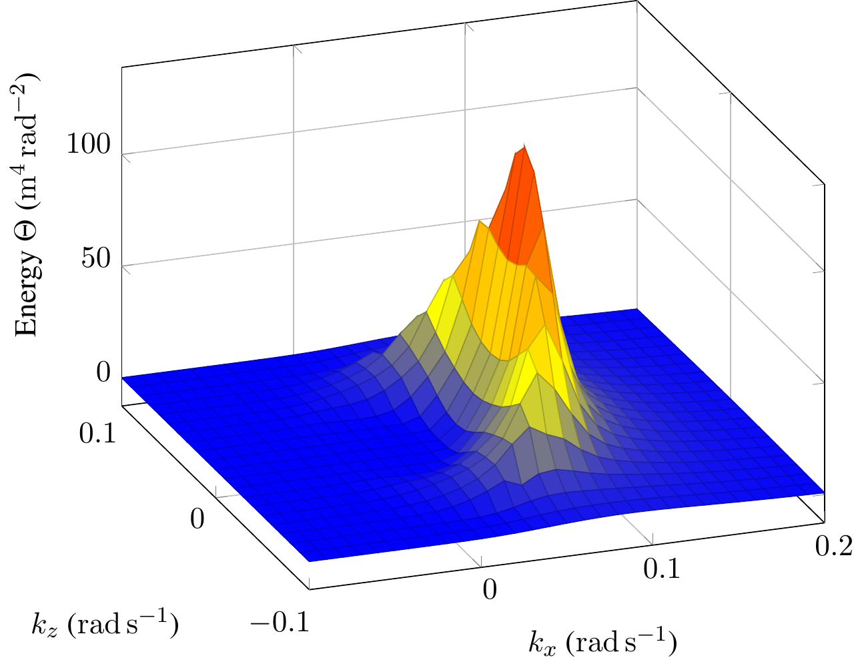
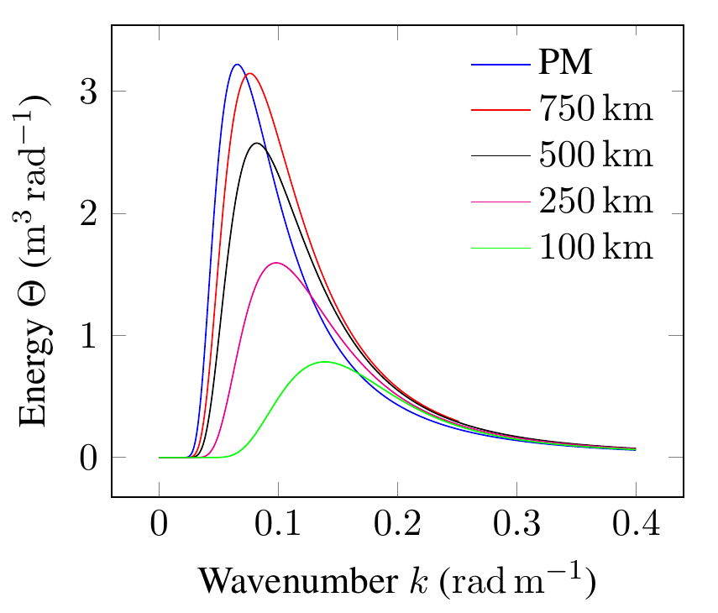

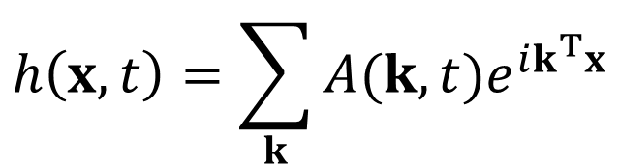
Wave spectrum
$$h\left(x,t\right)=\sum_{k}{A(k,t)e^{ik^{T}x}}$$

Slide 19
Evaluated wave spectra (1/2)
Pierson Moskowitz
Works best for gentle seas
Awesome with lighting
JONSWAP
Suitable for agitated seas
Works well with lighting, except low fetch conditions
Donelan
Suitable for all kinds of sea
Lighting is a disaster

Slide 20
Evaluated wave spectra (2/2)
Unified
For all seas between PM and JONSWAP
Good with small wavelengths -> closeups
Works flawlessly with lighting
Tessendorf
Geometry is a disaster, no further analysis

Slide 21
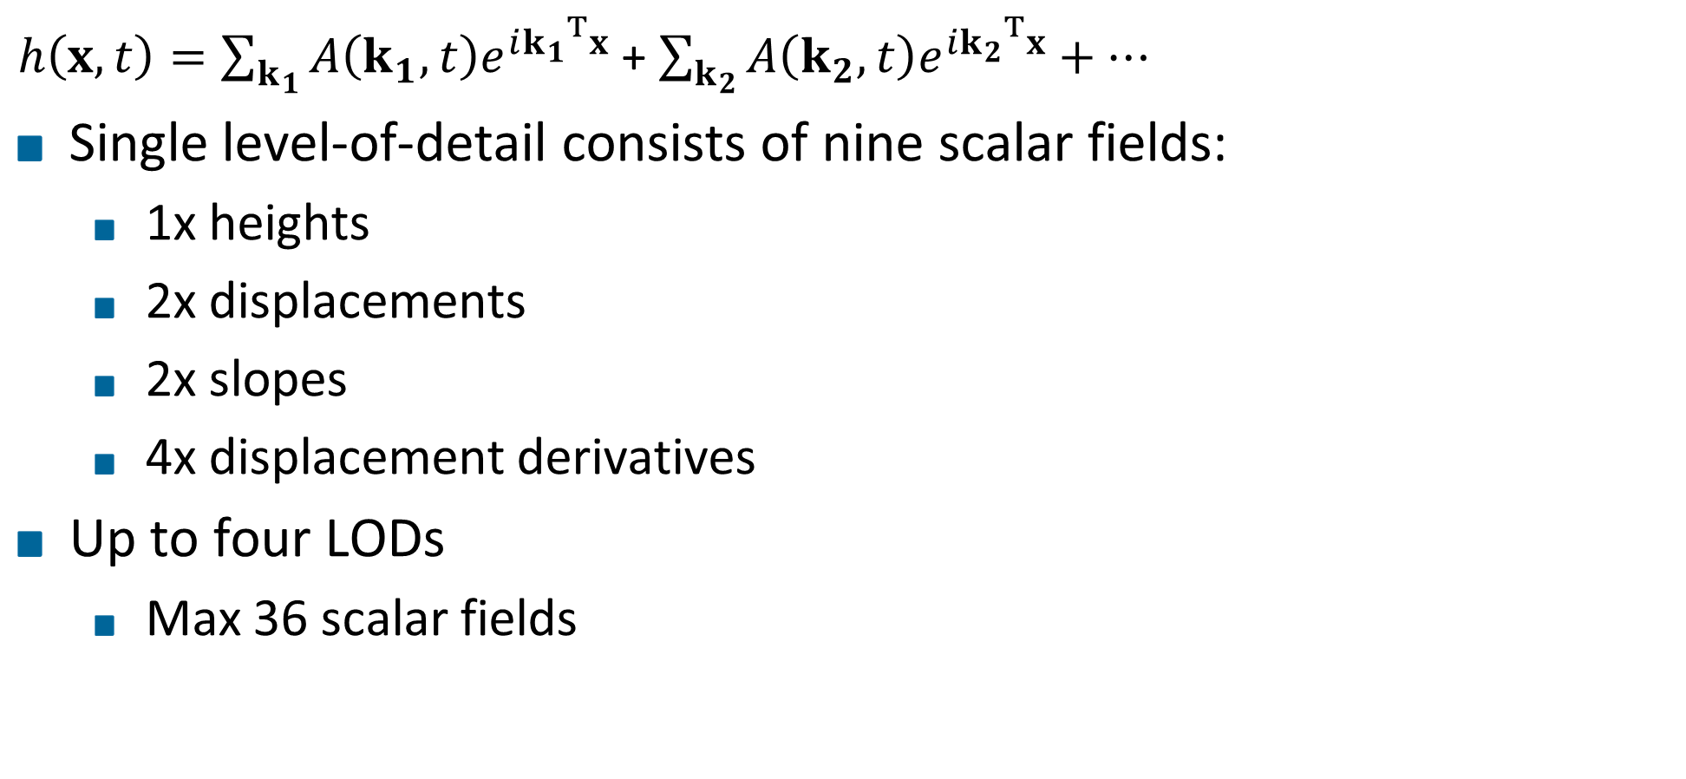
Level of detail
$h\left(x,t\right)=\sum_{k_{1}}{A\left(k_{1},t\right)e^{i{k_{1}}^{T}x}}$ + $\sum_{k_{2}}{A\left(k_{2},t\right)e^{i{k_{2}}^{T}x}}+…$
Single level-of-detail consists of nine scalar fields:
1x heights
2x displacements
2x slopes
4x displacement derivatives
Up to four LODs
Max 36 scalar fields

Slide 22
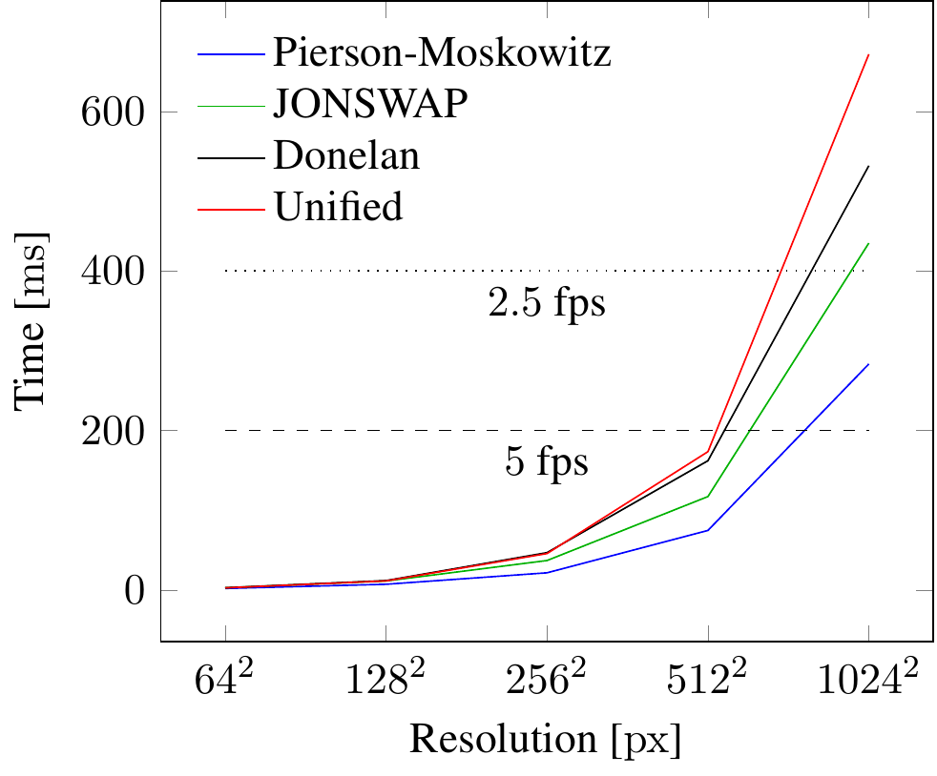
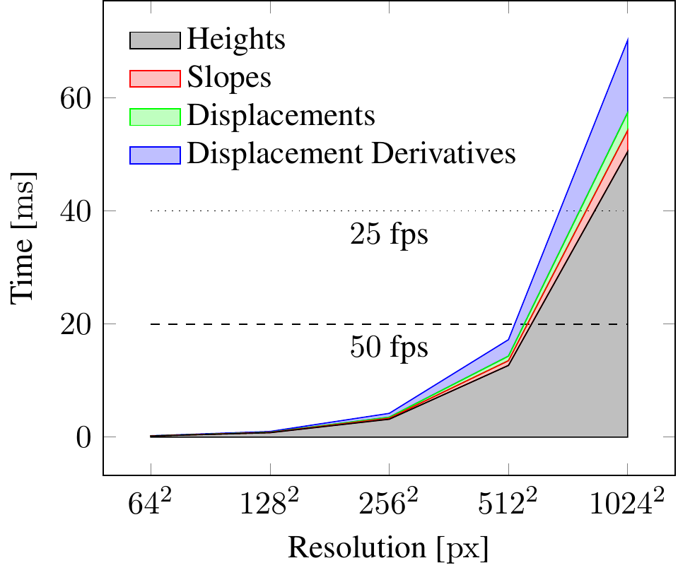
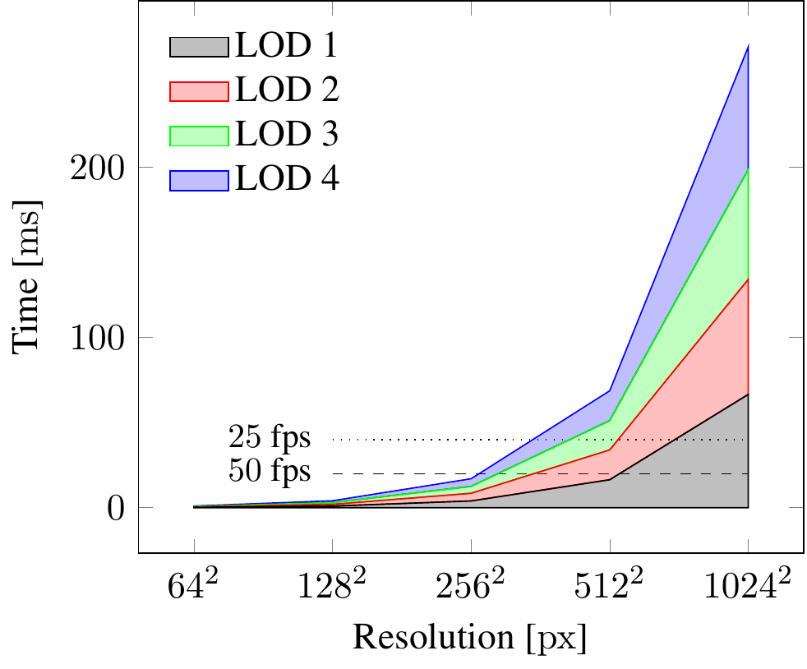
Performance LOD generation

Slide 23

Performance FFT
Pack nine scalar fields into 5

Slide 24
Future Work

Slide 25
Motivation
Challenges:
Ocean is dynamic and complex
Closeups and views to the horizon
Lighting
Notes:
Generation, animation and rendering of the surface of an open ocean in real time.

Slide 26
Headline
Level 0
Level 1
Level 2
Hint: Do NOT use bullet lists wherever possible !!!

Slide 28
Sometimes a dark background is better. Use this template.

Slide 29
Thank You for your Attention!
Don't forget to include a last slide that contains teaser images or a video or something else that reminds people about what you said.
It might well be that this slide will be on the screen during the whole discussion!

Slide 30
Multi-Res
Support two distinct resolutions
Heights and displacements
Slopes and displacement derivatives
Only up to 10% gain for generation
Speedup in FFT up to 40% because low-res FFT basically negligible
Further improvements down the line because less data to transfer and to process

Slide 31
Motivation
Notes:
Sunset over the ocean.

Slide 32
Motivation
Notes:
Perfectly calm arctic sea.

Slide 33
Motivation
Notes:
Storm waves.

Slide 34
Wave spectrum models
Five spectra implemented
Two work flawlessly
One works conditionally
Two were disqualified

